Slide 1
Detecting Corrugation Defects in Harbour Railway Networks Using Axle Box Acceleration Data
Judith Heusel, Benjamin Baasch, Wolfgang Riedler, Michael Roth,
Sangeetha Shankar, Jörn C. Groos
German Aerospace Center (DLR e.V.)
CM Conference 2021

Slide 2
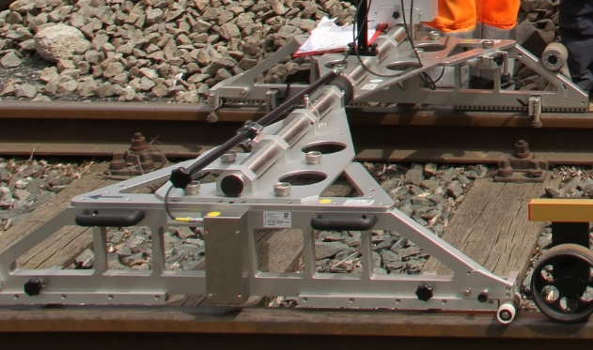
State-of-the-art Condition Monitoring in Small and Mid-size Railway Networks and Condition Monitoring via Usage of Embedded Sensors

Slide 3
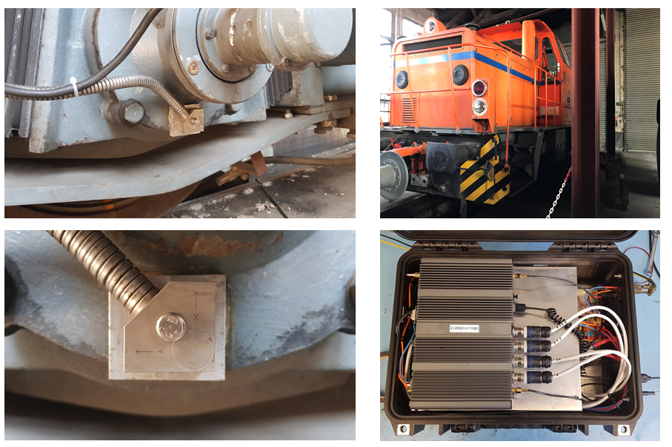
State-of-the-art Condition Monitoring in Small and Mid-size Railway Networks and Condition Monitoring via Usage of Embedded Sensors
Wheel
Longitudinal profile
Rail
Sleeper

Slide 4
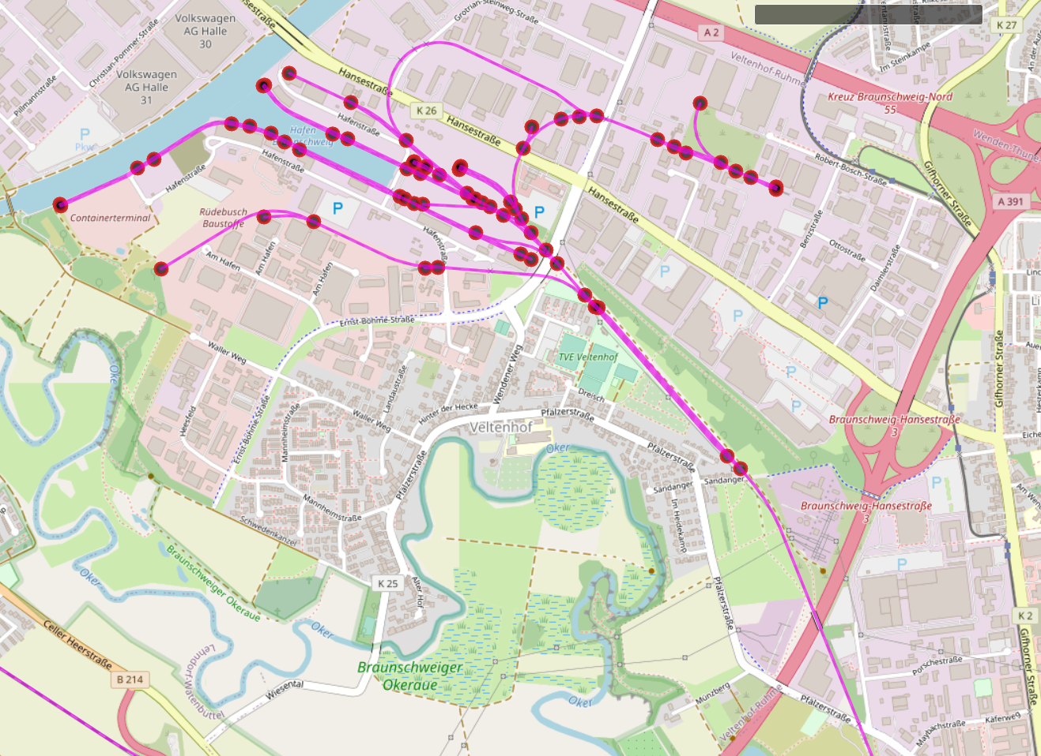
The Railway Network: Brunswick Inland Harbour (Germany)
15 km overall track length
Two operating locomotives, one is equipped with the multi-sensor unit
Low speeds: Running speed up to ~ 6 m/s
© OpenStreetMap contributors

Slide 5
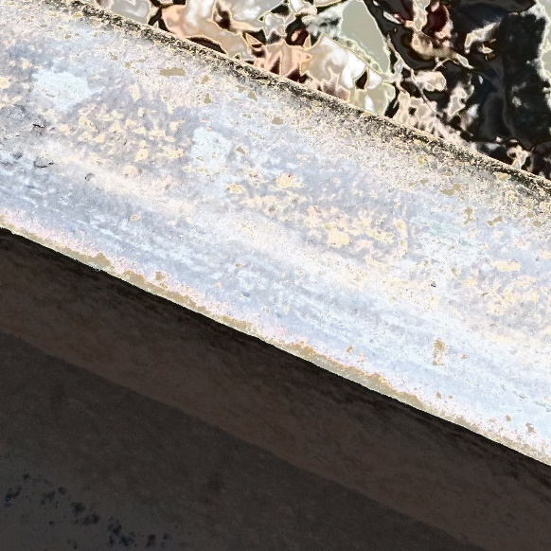
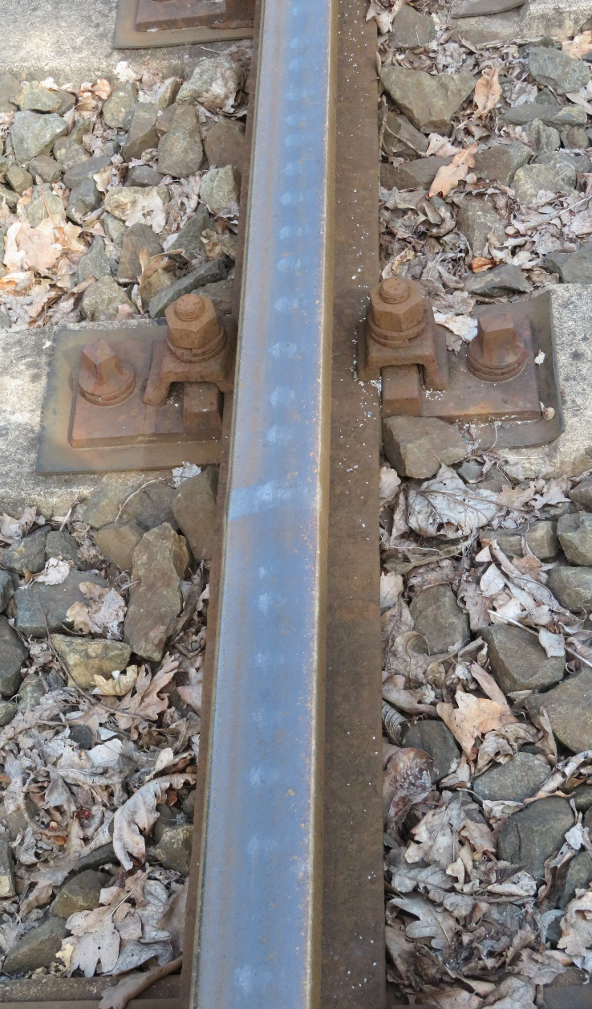
The Use Case: Corrugation
Periodic defect of the rail surface
Different development mechanisms
Typical wavelengths 25 mm – 1,500 mm
Amplitudes 0.01 mm – 0.4 mm

Slide 6
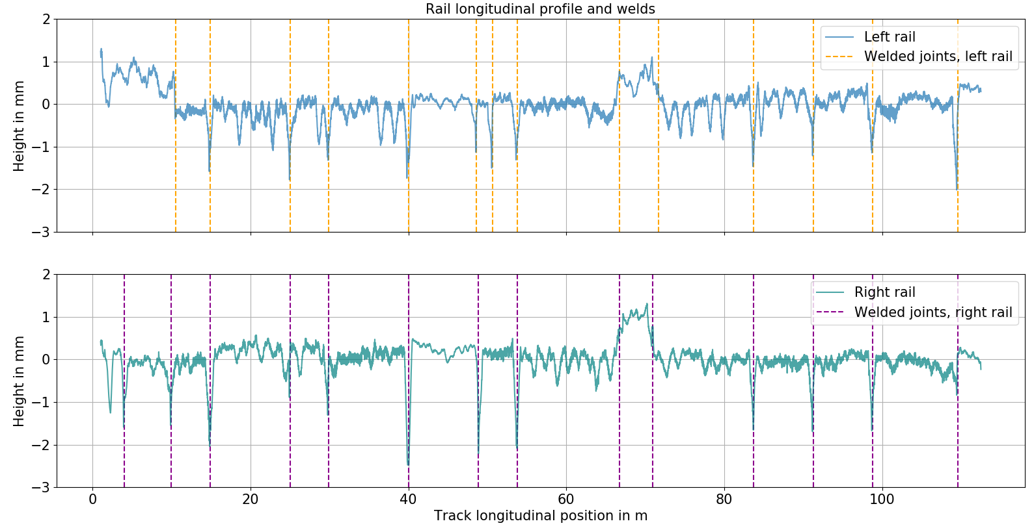
The Ground Truth: Reference Data Measurements in Brunswick Harbour
Measurements of the rail longitudinal profile
Height measurement every 2 mm
Completed by additional visual inspections (welds)

Slide 7
The Ground Truth: Reference Data Measurements in Brunswick Harbour
Measurements of the rail longitudinal profile
Height measurement every 2 mm
Completed by additional visual inspections (welds)

Slide 8
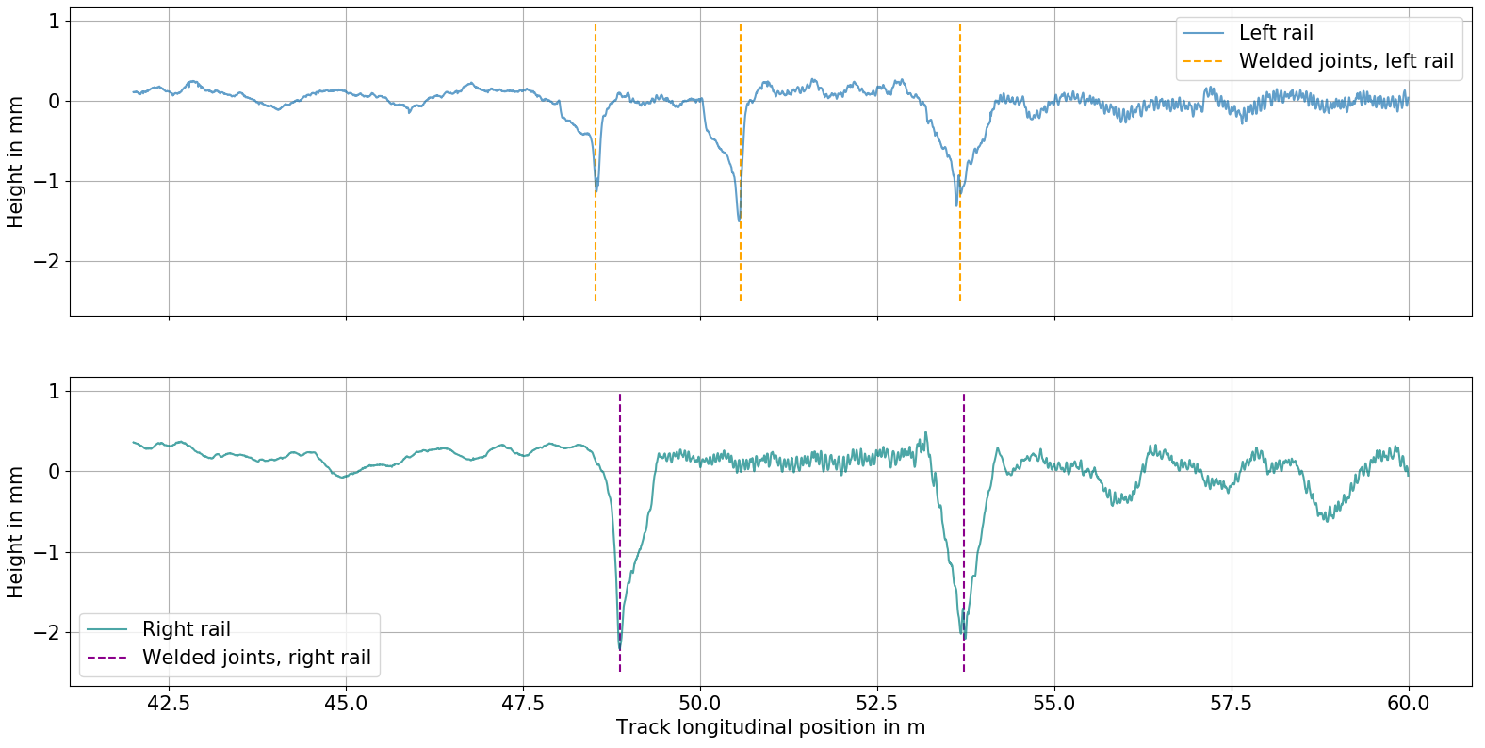
The Use Case: Corrugation in Brunswick Harbour
Depicted track longitudinal profile:
Ensemble of corrugated and non-corrugated segments, divided by welds
Re-used rails from main lines

Slide 9
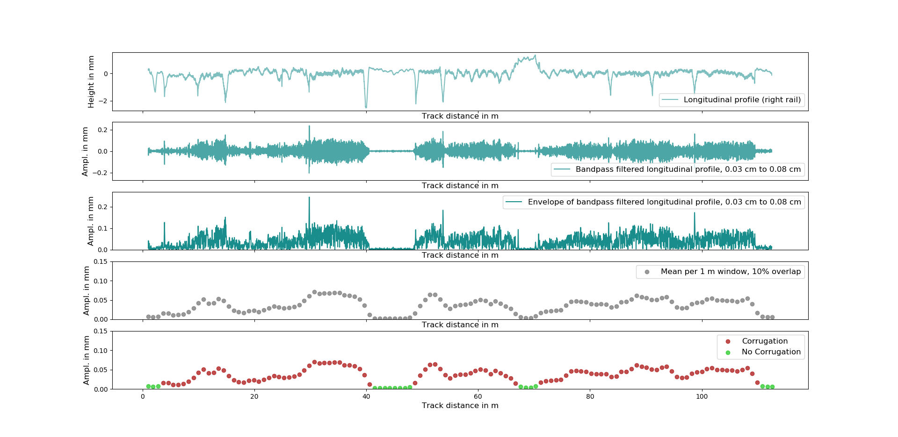
Data Analysis: Processing Sequence of Reference Data
Longitudinal profile

Slide 10
Data Analysis: Processing Sequence of Reference Data
Longitudinal profile
Bandpass filtering

Slide 11
Data Analysis: Processing Sequence of Reference Data
Longitudinal profile
Bandpass filtering
Envelope

Slide 12
Data Analysis: Processing Sequence of Reference Data
Longitudinal profile
Bandpass filtering
Envelope
Mean per segment
Assessment

Slide 13
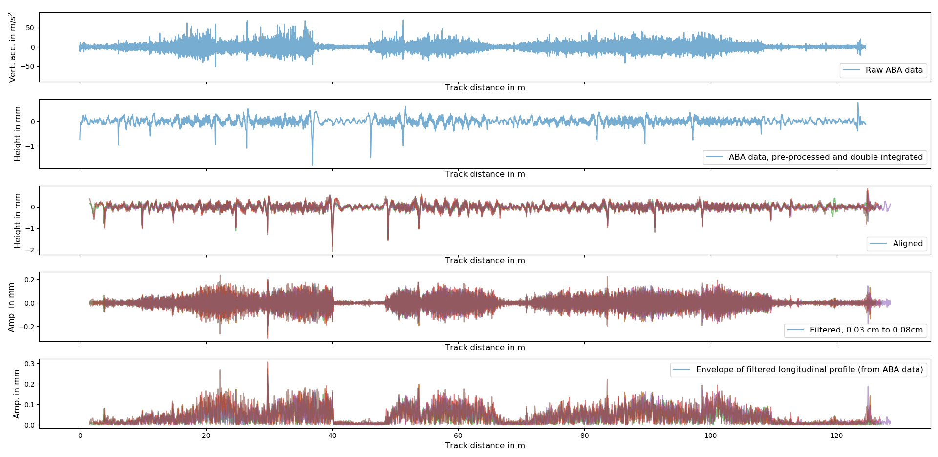
Data Analysis: Processing Sequence of Axle-Box Acceleration (ABA) Data
Raw ABA data
Spatial signal alignment
Bandpass filtering
Envelope

Slide 14
Data Analysis: Processing Sequence of Axle-Box Acceleration (ABA) Data
Raw ABA data
Data pre-processing + double integration
Spatial signal alignment
Bandpass filtering
Envelope

Slide 15
Data Analysis: Processing Sequence of Axle-Box Acceleration (ABA) Data
Raw ABA data
Data pre-processing + double integration
Spatial signal alignment
Bandpass filtering
Envelope

Slide 16
Data Analysis: Processing Sequence of Axle-Box Acceleration (ABA) Data
Raw ABA data
Data pre-processing + double integration
Spatial signal alignment
Bandpass filtering
Envelope

Slide 17
Data Analysis: Processing Sequence of Axle-Box Acceleration (ABA) Data
Raw ABA data
Data pre-processing + double integration
Spatial signal alignment
Bandpass filtering
Envelope

Slide 18
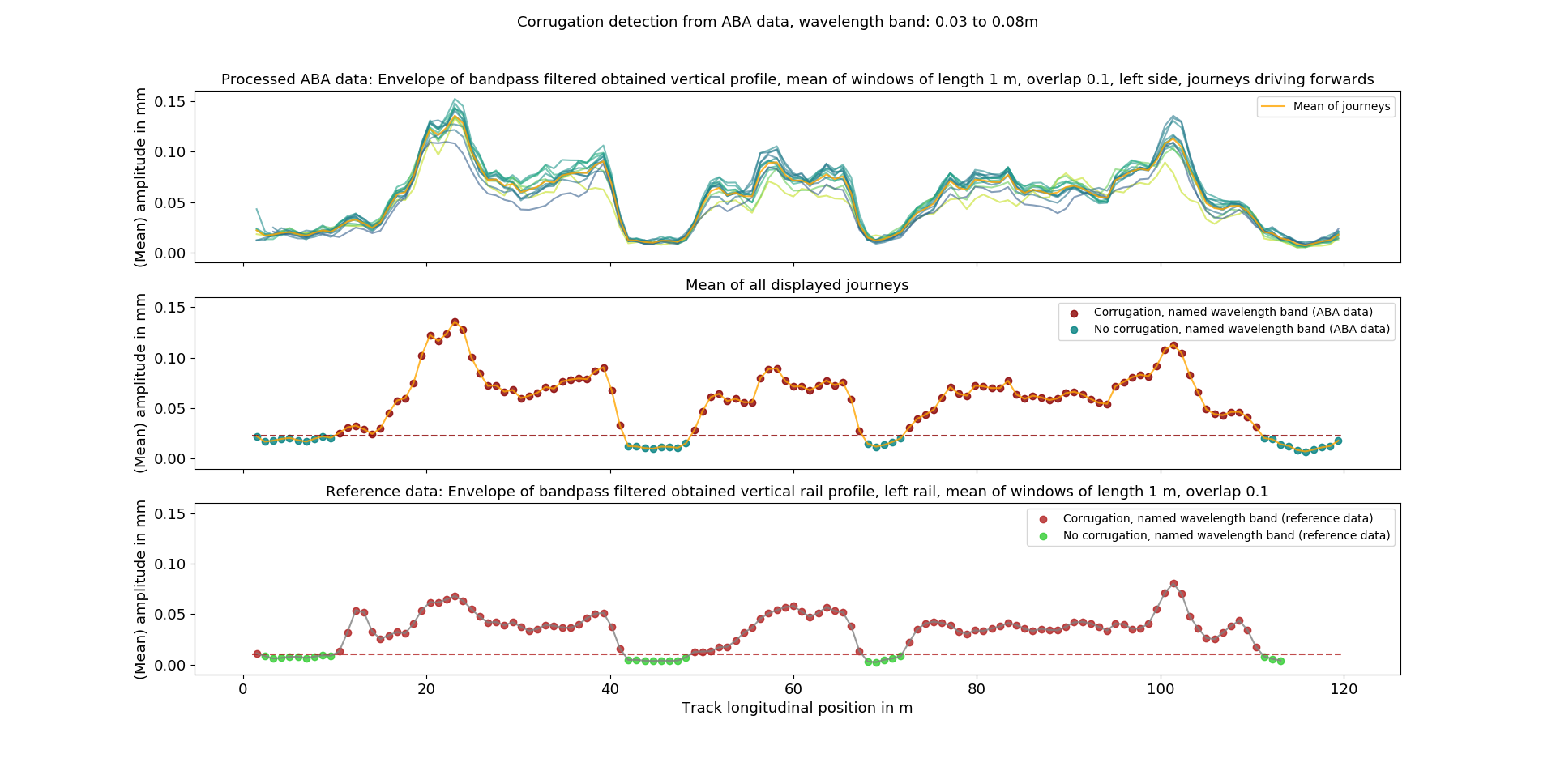
Data Analysis: Results
Wavelengths:
3 – 8 cm
Left Rail
Mean of displayed journeys (processed axle box acceleration data)

Slide 19
Data Analysis: Results
Wavelengths:
3 – 8 cm
Left Rail
Mean of displayed journeys (processed axle box acceleration data)
Reference data

Slide 20
Data Analysis: Results
Wavelengths:
3 – 8 cm
Left Rail:
Accuracy $≥$
98.4%
Right Rail:
Accuracy $≥$
96%
Reference data

Slide 21
Conclusion and Outlook
The longitudinal rail profile is well represented by the processed axle-box acceleration data Strong depressions in the longitudinal profile are detectable from the sensor data

Slide 22
Conclusion and Outlook
The longitudinal rail profile is well represented by the processed axle-box acceleration data Strong depressions in the longitudinal profile are detectable from the sensor data
Classification based on ABA data yields good results, corrugation is detected with high accuracy

Slide 23
Conclusion and Outlook
The longitudinal rail profile is well represented by the processed axle-box acceleration data Strong depressions in the longitudinal profile are detectable from the sensor data
Classification based on ABA data yields good results, corrugation is detected with high accuracy
Application of the presented approach to a larger data set (whole track infrastructure in Brunswick harbour)

Slide 24
Conclusion and Outlook
The longitudinal rail profile is well represented by the processed axle-box acceleration data Strong depressions in the longitudinal profile are detectable from the sensor data
Classification based on ABA data yields good results, corrugation is detected with high accuracy
Application of the presented approach to a larger data set (whole track infrastructure in Brunswick harbour)
Investigation of traces of the longitudinal profile of the opposite rail on the sensor data and inclusion to the evaluation process

Slide 25
Conclusion and Outlook
The longitudinal rail profile is well represented by the processed axle-box acceleration data Strong depressions in the longitudinal profile are detectable from the sensor data
Classification based on ABA data yields good results, corrugation is detected with high accuracy
Application of the presented approach to a larger data set (whole track infrastructure in Brunswick harbour)
Investigation of traces of the longitudinal profile of the opposite rail on the sensor data and inclusion to the evaluation process
Analysis concerning quantitative longitudinal profile information, i.e. regression of wavelength-dependent component parameters

Slide 26
Thank you for your attention!

